Slide 1
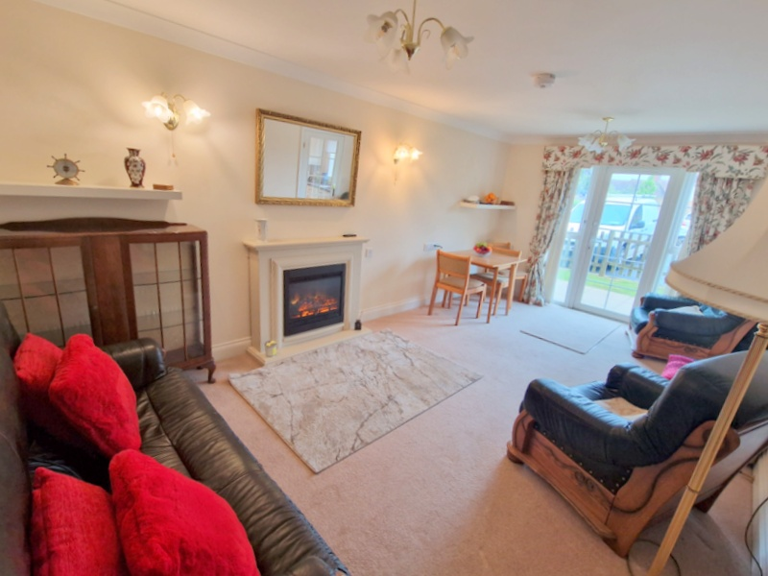
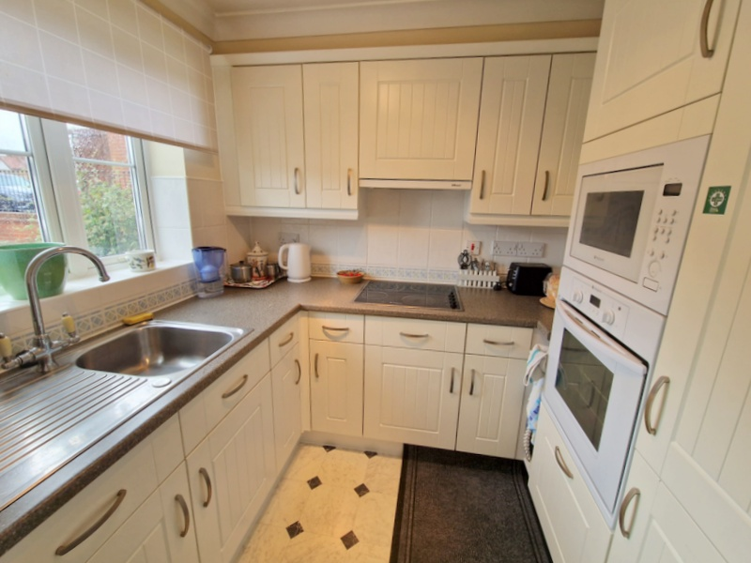
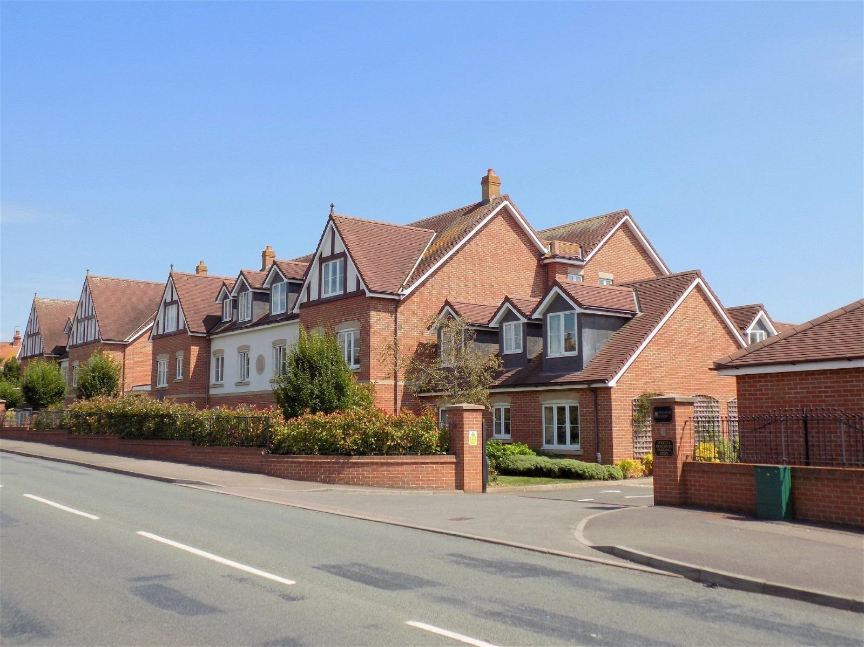
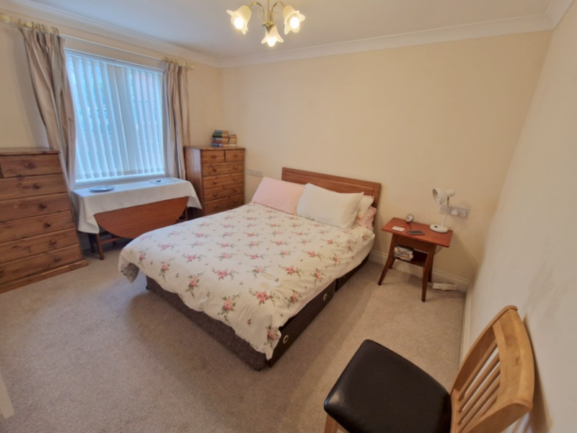
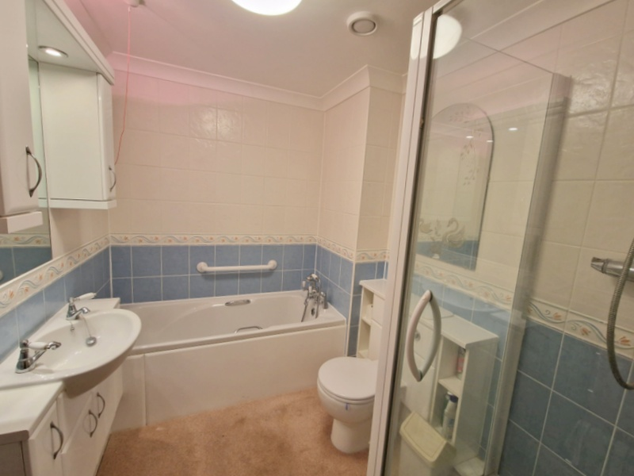
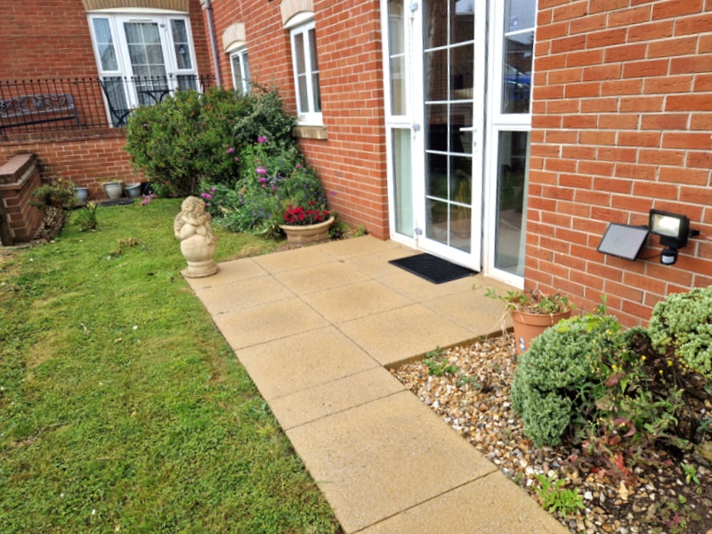
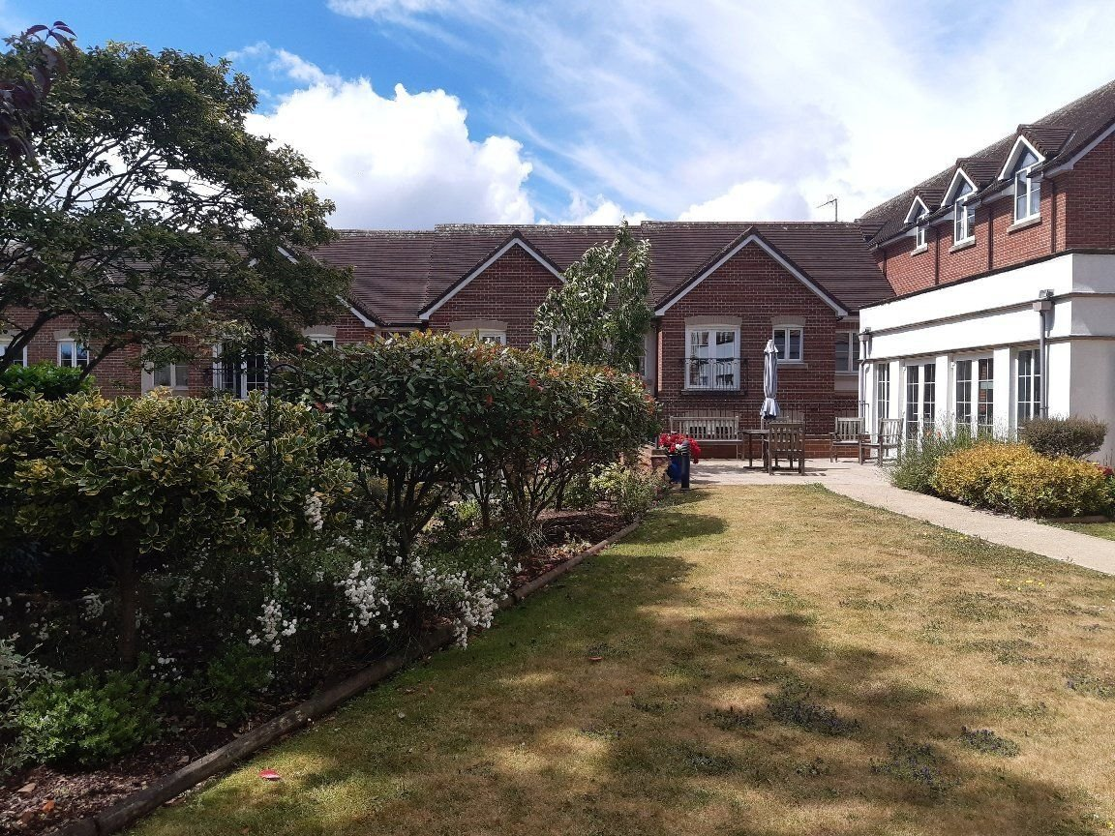
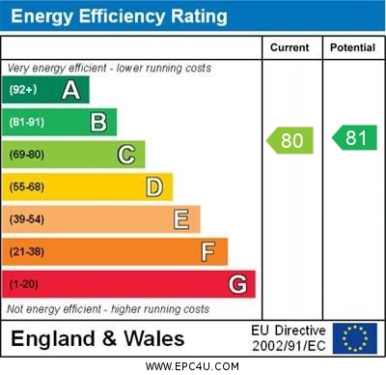
www.pennys.net
14 Pegasus Court, 88 Salterton Road, Exmouth, EX8 2NN
GUIDE PRICE £149,950
TENURE Freehold
A Delightful Retirement Apartment Located On The Ground Floor To The Side Of The Development Shown Close To Local Bus Service, Shops And Supermarkets
Well Presented Accommodation Offered In Excellent Condition • Reception Hall •
Lounge/Dining Room With Access To Patio •
Well Equipped Kitchen With Integrated Appliances • Double Bedroom With Built-in Wardrobe • Bathroom With Bath & Separate Shower Cubicle • Delightful Communal Well Tended Grounds • Secure Parking Area With Spaces Subject To Availability •
House Manager & Care Line Support • Excellent Communal Facilities •
Pennys Estate Agents Limited for themselves and for the vendor of this property whose agents they are give notice that:- (1) These particulars do not constitute any part of an offer or a contract. (2) All statements contained in these particulars are made without responsibility on the part of Pennys Estate Agents Limited. (3) None of the statements contained in these particulars are to be relied upon as a statement or representation of fact. (4) Any intending purchaser must satisfy himself/herself by inspection or otherwise as to the correctness of each of the statements contained in these particulars. (5) The vendor does not make or give and neither do Pennys Estate Agents Limited nor any person in their employment has any authority to make or give any representation or warranty whatever in relation to this property.
PENNYS ESTATE AGENTS
2 Rolle House, Rolle Street, Exmouth, Devon, EX8 2SN
Tel: 01395 264111 EMail: help@pennys.net

Slide 2
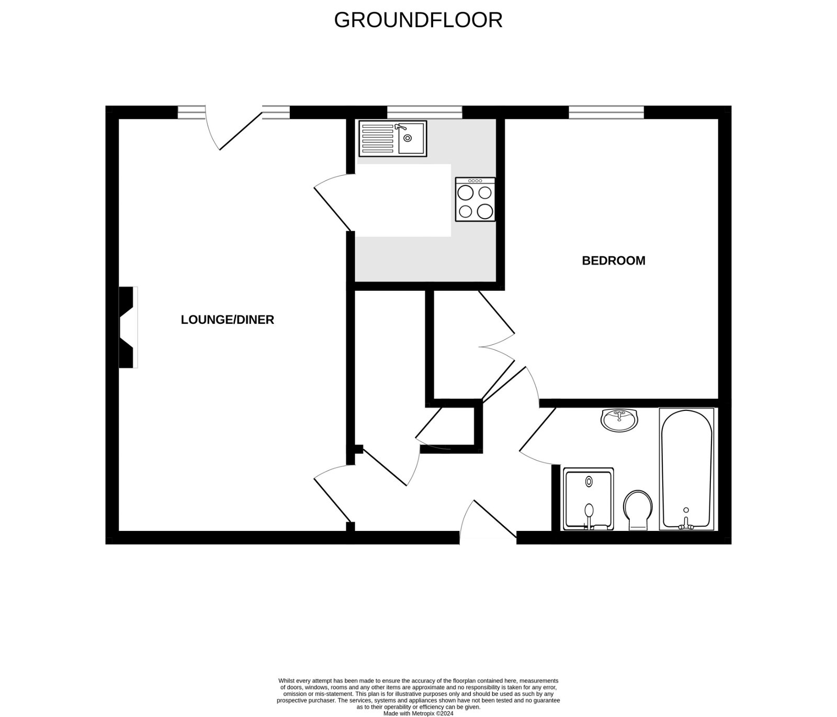
14 Pegasus Court, 88 Salterton road, Exmouth, EX8 2NN
Pegasus Court is a modern retirement development built with quality and elegance immediately evident. The attention to detail in communal areas as well as the apartment itself is worthy of special note. The kitchen is a superb feature of the property being fully equipped, well planned and designed. A clever carousel unit in the kitchen makes the most of the space, while the modern oven, hob, microwave and fridge/freezer are all built in. The taps in the kitchen and the fitted bathroom are easy to operate and hot water is available on demand from the economic heating system. In each room sockets are placed at waist height for greater convenience, and should assistance ever be needed, there are unobtrusive Careline units which can bring immediate response, coupled with the House Manager available from approximately 9am to 5pm, Monday to Friday. There is an age restriction on the development, and residents must be aged 60 years or over.
THE ACCOMMODATION COMPRISES: Communal entrance with security door giving access to communal areas. This flat is located on the ground floor to the side of the building and enters via private front door and letterbox giving access to:
RECEPTION HALL: Walk-in linen/storage cupboard housing water cylinder and slatted shelving. Second storage/coats cupboard with hanging rail and shelf. Slimline electric panel heater, emergency careline cord/speech unit.
LOUNGE/DINING ROOM: 5.66m x 3.2m (18'7" x 10'6") A bright spacious room with double glazed window and door opening onto the patio sun terrace, attractive fire surround housing living flame effect electric fire, TV point, telephone point, slimline electric heater.
KITCHEN: A well equipped kitchen with double glazed window and comprising a range of worktops with cupboards and drawer units beneath and inset single drainer sink unit, built-in high level oven with built-in ceramic hob with extractor hood over and microwave, integrated fridge and freezer, wall mounted cupboards.
BEDROOM: 3.61m x 3.2m (11'10" x 10'6") Double glazed window, electric wall heater, TV point.
BATHROOM/WC: Well appointed and comprising of a bath with shower attachment; separate shower cubicle with shower unit, hand rail and splash screen door; wash hand basin set in display surface with cupboards below and fitted mirror with display lighting over and matching cupboards to either side; WC with concealed cistern; fully tiled walls; coved ceiling; ceiling extractor fan; electric chrome heated towel rail; electric wall heater; emergency care line cord.
TENURE AND OUTGOINGS: Service Charge: £1,827.18 – half yearly.
COMMUNAL FACILITIES: The communal areas are worthy of special note with a most attractive communal lounge, spacious laundry room, quality visitor suite, library and superb communal gardens. The parking area is accessed via electronic gates with spaces subject to availability.
OUTSIDE: The property enjoys superb communal landscaped gardens to the rear of the building offering an array of colour with a gazebo, various seating areas and raised patio sun terrace. There is also a secure parking area with parking spaces subject to availability.
FLOOR PLAN:

